Slide 1
G-SUITE METRICS CSC 505/605 Fall 2019
By: Advisor :
Lavanya Goluguri Dr. Sowmya Mohanty
Anusha Vanama Mentor:
Jackie Cuong Nick Young
Henry Reichard
Hieu Vo

Slide 2
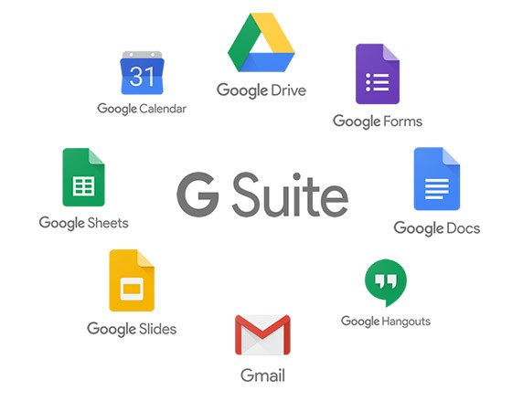
PROJECT OVERVIEW
G Suite is a set of cloud computing, productivity and collaboration tools, software and products developed by Google.
G-suite services include Google Accounts, Google Calendar, Google Hangouts, Gmail, Google+, google drive/docs, Chrome OS devices, Google sites, Mobile devices google applications etc.
It gives us information about G-suite services usage, for all the users across an entire domain. Here the data is collected for the UNCG users that is automatically pulled into Splunk from Google.

Slide 3
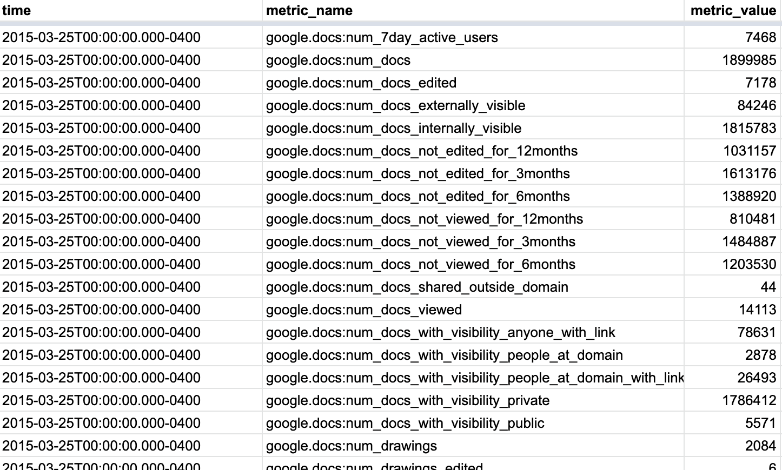
DATA DESCRIPTION
The data set it is in .CSV format.
The data set size is 611,914 rows.
The data is collected from March 23rd , 2015 to August 17th, 2019.
It has three attributes:
Time - The day for which the data is collected. (format: yy-mm-dd hr:min:sec:msec)
Metric_Name - It is name of the google service used with their parameter.
Metric_Value - It is number associated with the metric, it can be number of users, number of docs, mb of data used for the application on that day, etc.

Slide 4
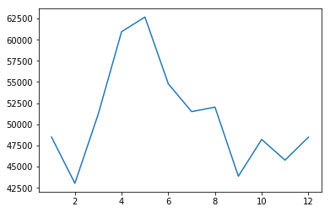
GOALS OF THE PROJECT
Performing Analysis on the data set.
Finding Anomalies by comparing the values in the data set using timestamp, metric_name and metric_value.
Prediction of future metric value based on the current data set values.
Visualization and simple dashboard development from the findings using Google Data Studio or Splunk.

Slide 5
TASKS FOR EACH MEMBER
Each Member of our team is focusing on initial data analysis and data cleaning while picking different tasks in reaching our final goal of visualization and anomalies prediction.
Lavanya Goluguri: Focusing on Month by Month Analysis on Metrics and parameter values.
Anusha Vanama : Focusing on Year by year analysis on Metrics and its values.

Slide 6
TASKS FOR EACH MEMBER
Jackie Cuong: Focuses on week wise Analysis on Metrics and parameter values.
Henry Reichard: Focuses on Semester analysis on Metrics and its values.
Hieu Vo: Focuses on day by day analysis.

Slide 7
RELATED WORK BY OTHERS
Work Insights:
This is a tool provided by Google itself where provides detailed metrics on your organization's G Suite usage.
https://gsuite.google.com/products/workinsights/
Zoho Workplace is a fully-featured online office suite
that collaborates on documents, spreadsheets, and presentations and we get insights on it from Zia- AI assistant.
https://www.zoho.com/workplace/?src=top-header&ireft=One

